Slide 1
Thickshake TOWARDS A SMARTER LIBRARY CATALOGUE
Mark Shelton | Curtin HIVE | 18 March 2018
github.com/markshelton/thickshake
Project sponsored by the Pawsey Supercomputing Centre.

Slide 2
Catalogue Interface
Location Extraction → OldPerth
Face Detection → Subject Recognition
Text Detection → Text Recognition
Landmark Recognition
Image Captioning
Clustering | Similarity | Search
Complete | Work In Progress | Future Goals
Notes:
Green – complete
Yellow – in progress
Blue – future projects

Slide 3
Catalogue Interface
Library
Image File
Image Processors
Parallel Store
Machine Learning Classifiers
Pawsey Supercomputing Centre
Storage Interface
Report Writer
Report / Dump
Library
Library
MARC Record
MARC Reader
Relational Database
MARC Writer
Partial MARC Record
Library
Metadata Parsers

Slide 4
Location Extraction
Catalogue Field
Address
Location
311688PD: Durham House building premises of Wrightson Dance Studios, The Inn Trim hairdressers, Galore House (no. 842) and Marjorie Young Antiques (no. 836) Hay Street, Perth, December 1982
building_name: Durham House
street_number: ‘836-842’
street_name: 'Hay’
street_type: 'Street'
suburb: 'Perth’
state: 'WA'
longitude: 115.85448
latitude: -31.95236,
Notes:
Mappify API
2,500 request limit per day (free)
Based on PSMA G-NAF dataset

Slide 5
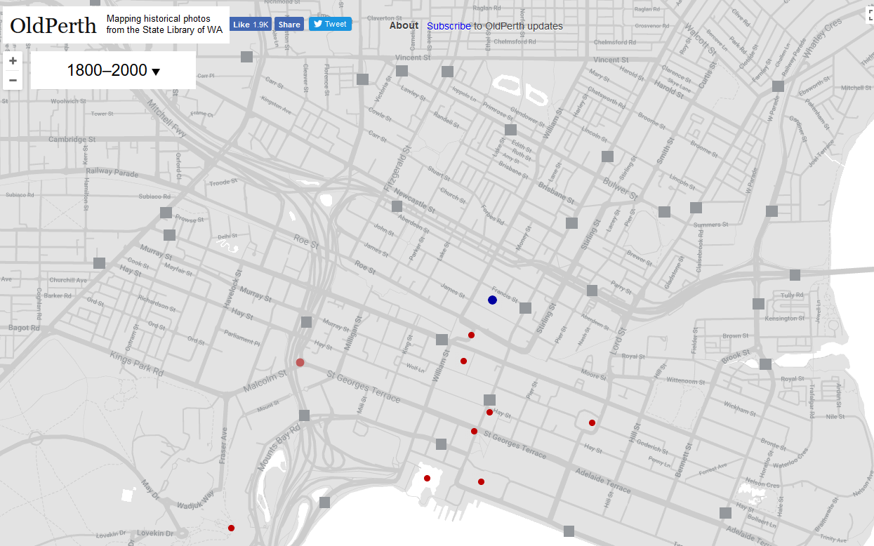
Location Extraction → OldPerth

Slide 6
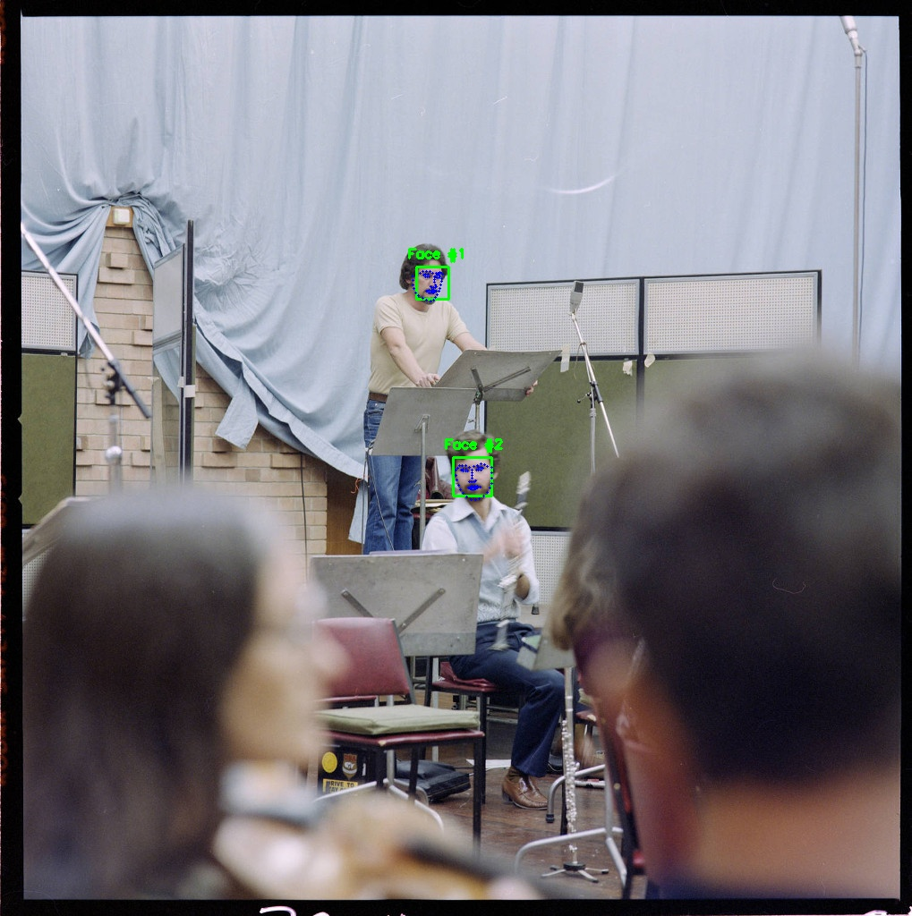
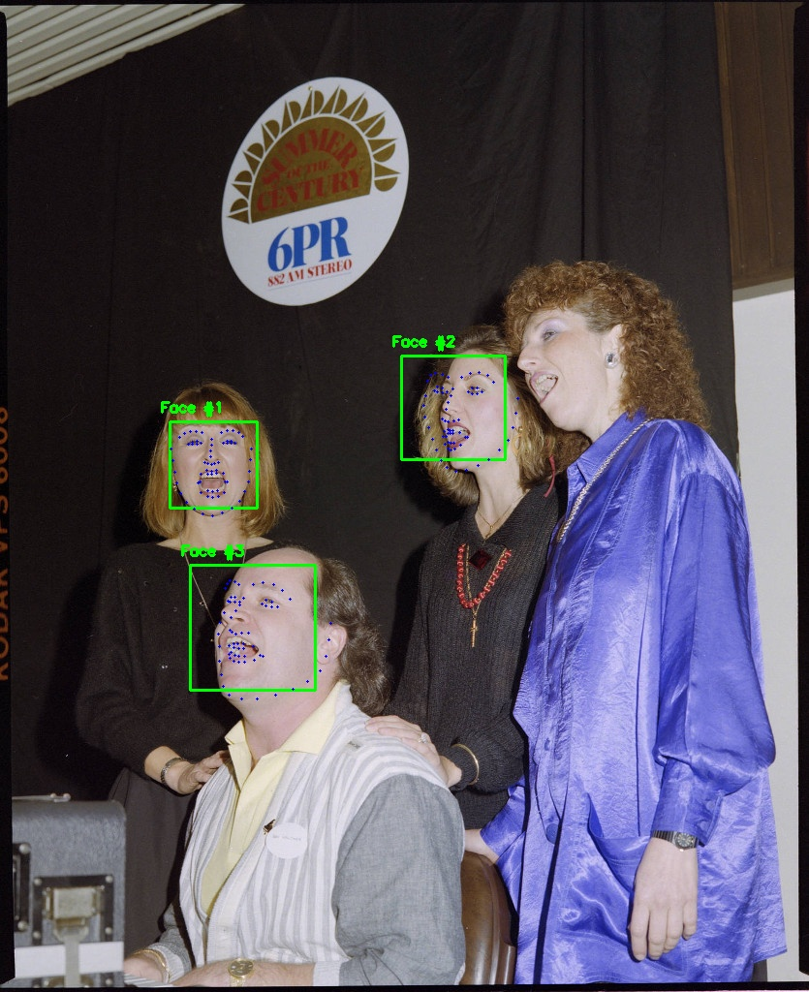
Face Detection

Slide 7
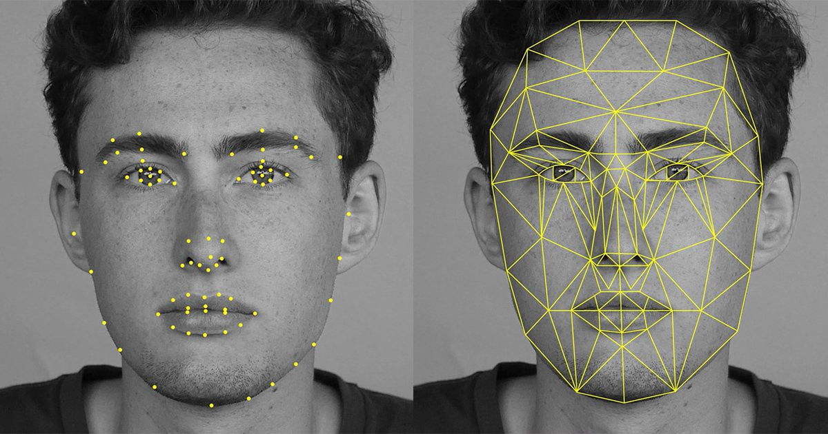
Face Detection → Subject Recognition
Facial Embeddings
“Fingerprint”
Existing Labels
Other Clues
Have we seen this person in other photos?
What do we know about the image?
Location
Dates
Topics
Other Subjects
Notes:
1. pre-process the image, 2. identify facial bounding boxes 3. identify facial landmarks, 4. generate facial encodings, 5. combine metadata and facial encodings, 6. train the neural network, 7. apply the trained neural network to make predictions.

Slide 8
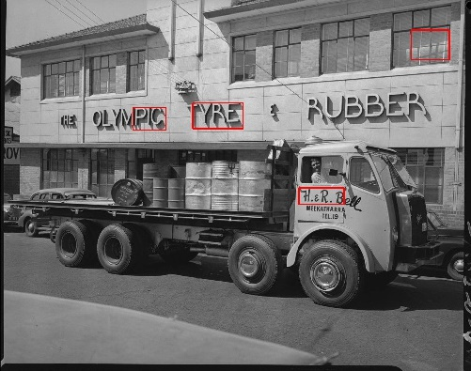
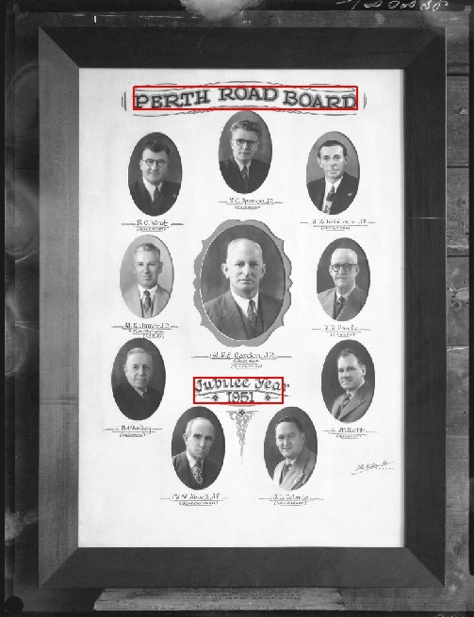
Text Detection

Slide 9
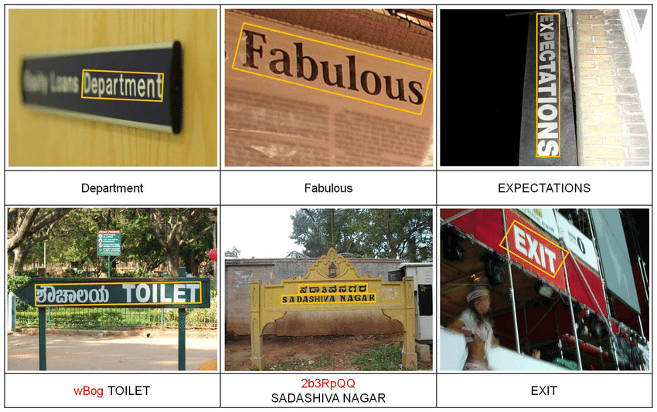
Text Detection → Text Recognition
Yao, C., Bai, X., & Liu, W. (2014). A unified framework for multi-oriented text detection and recognition. IEEE Transactions on Image Processing, 23(11), 4737-4749.

Slide 10
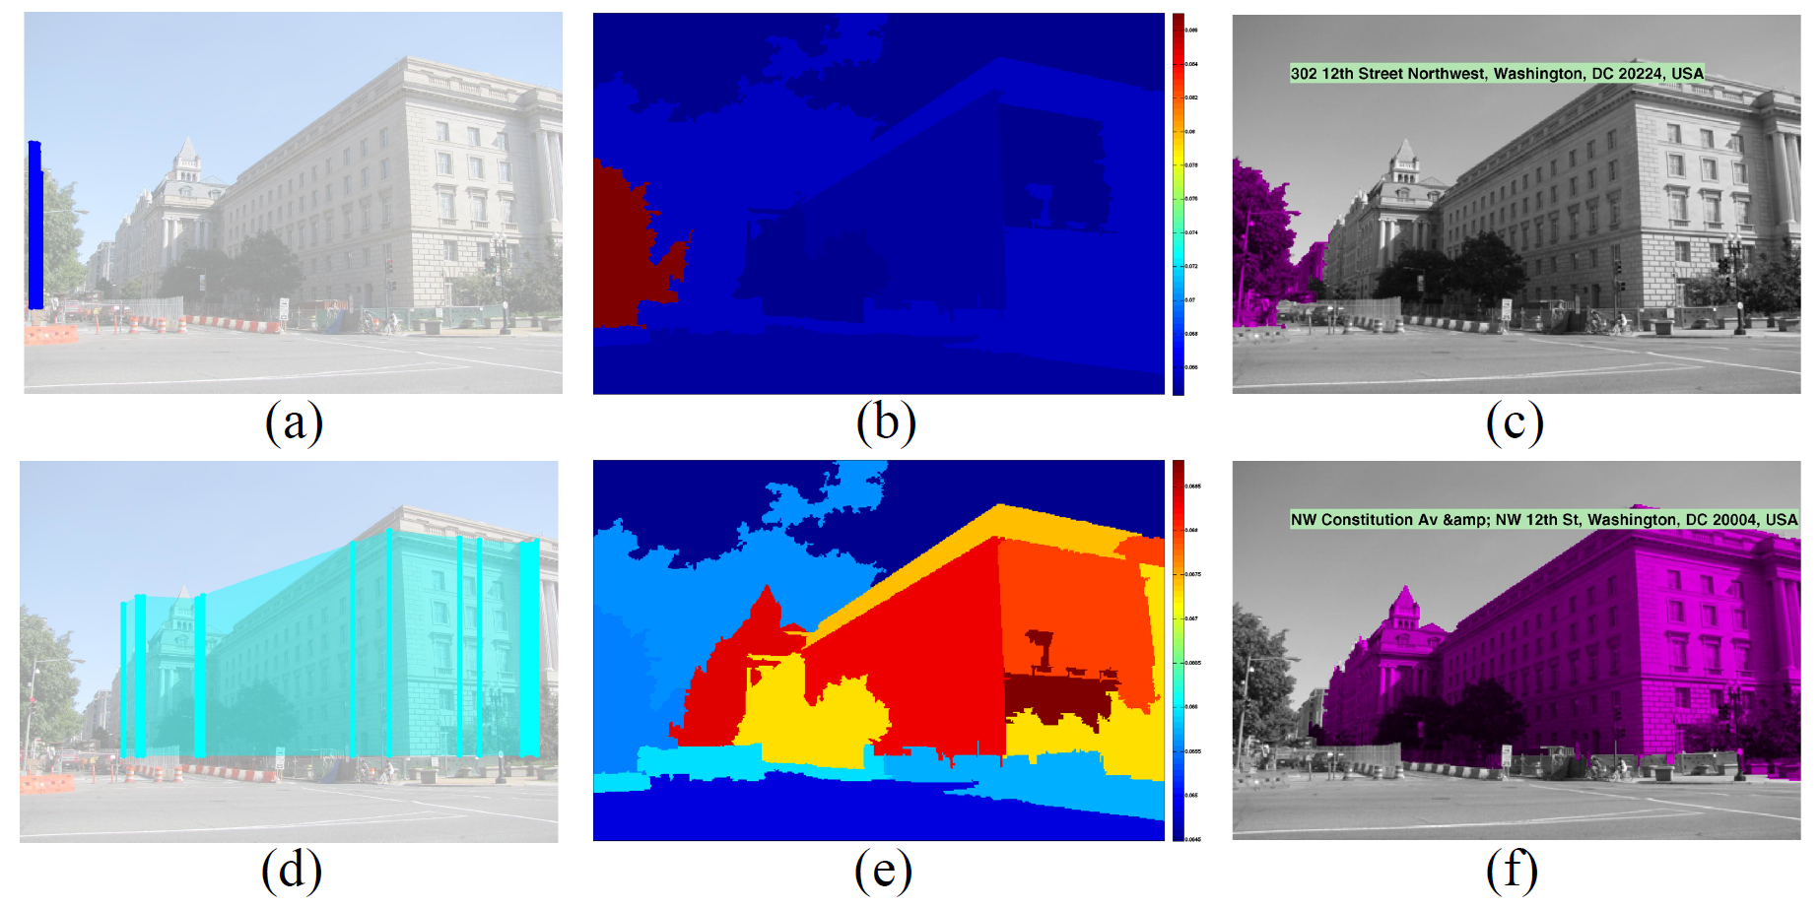
Landmark Recognition
Ardeshir, S., Malcolm Collins-Sibley, K., & Shah, M. (2015). Geo-semantic segmentation. In Proceedings of the IEEE Conference on Computer Vision and Pattern Recognition (pp. 2792-2799).

Slide 11
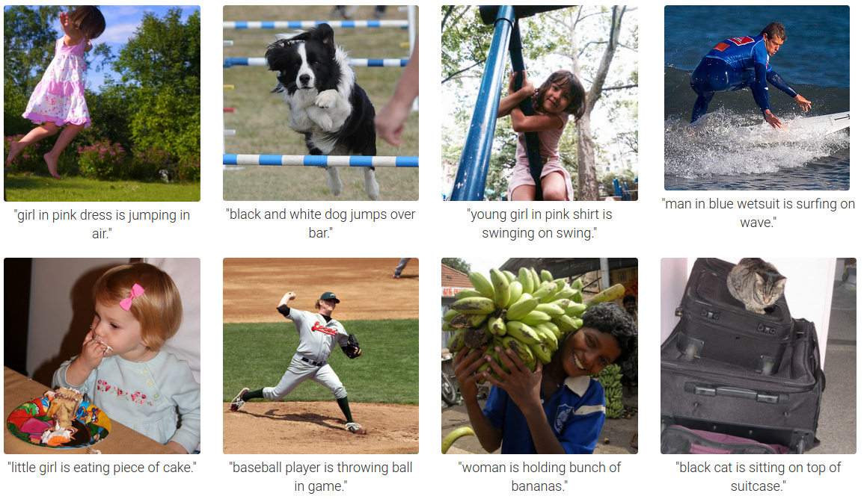
Image Captioning
Karpathy, A., & Fei-Fei, L. (2015). Deep visual-semantic alignments for generating image descriptions. In Proceedings of the IEEE conference on computer vision and pattern recognition (pp. 3128-3137).

Slide 12
Clustering | Similarity | Search
What images depict similar topics?
What images have a similar aesthetic?
What images were taken around the same location?
What images were taken around the same time?
What images depict this person?
What images depict this landmark?
…
Which people are related to this person?
Which images in the catalogue are most important?

Slide 13
Catalogue Interface
Location Extraction → OldPerth
Face Detection → Subject Recognition
Text Detection → Text Recognition
Landmark Recognition
Image Captioning
Clustering | Similarity | Search
Complete | Work In Progress | Future Goals
Notes:
Green – complete
Yellow – in progress
Blue – future projects

Slide 14
Thickshake TOWARDS A SMARTER LIBRARY CATALOGUE
Mark Shelton | Curtin HIVE | 18 March 2018
github.com/markshelton/thickshake
Project sponsored by the Pawsey Supercomputing Centre.

